Slide 1
02. Neural Network 동작 원리
2022-03-12
kts123@kookmin.ac.kr

Slide 2
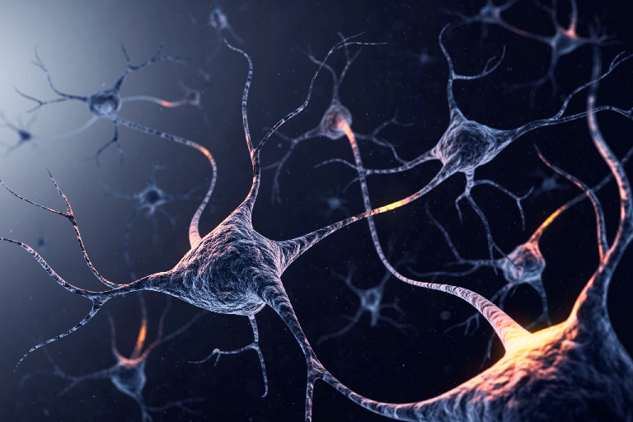

Slide 3
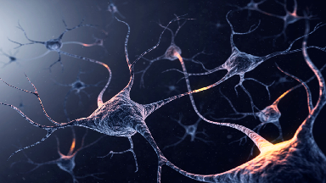
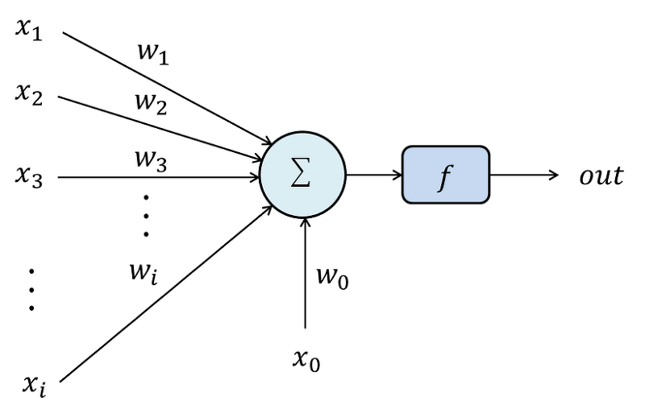

Slide 4
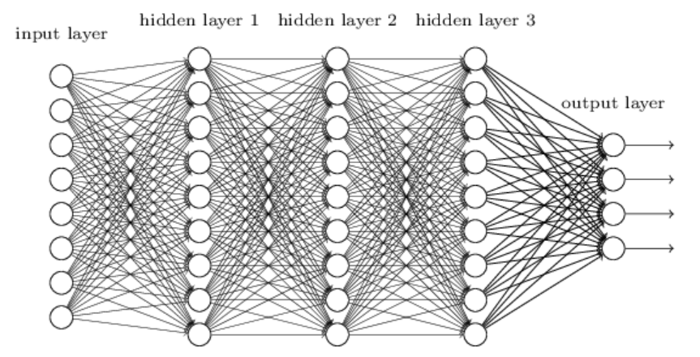

Slide 5
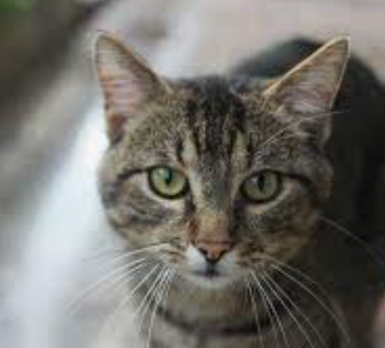
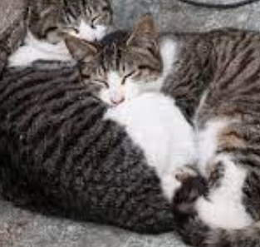
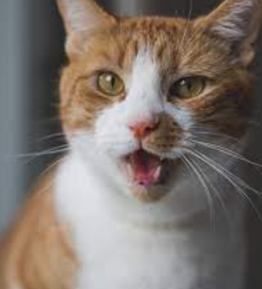

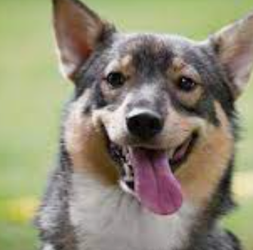
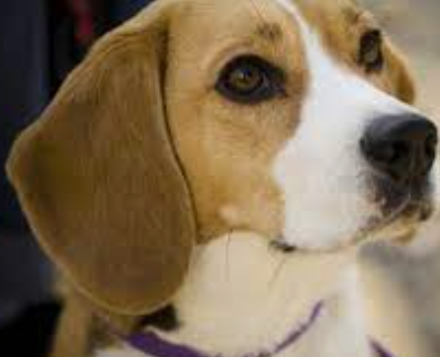
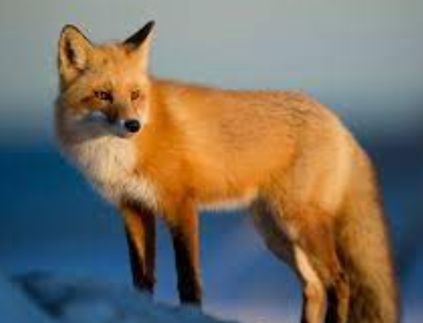
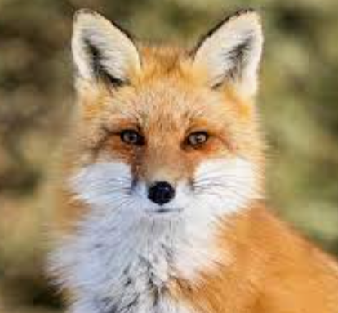
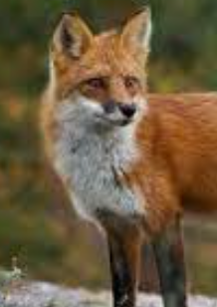
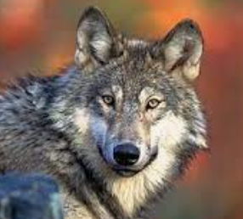
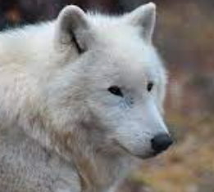
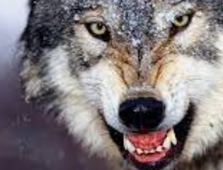
인식 (Recognition)
고양이
개
여우
늑대

Slide 6
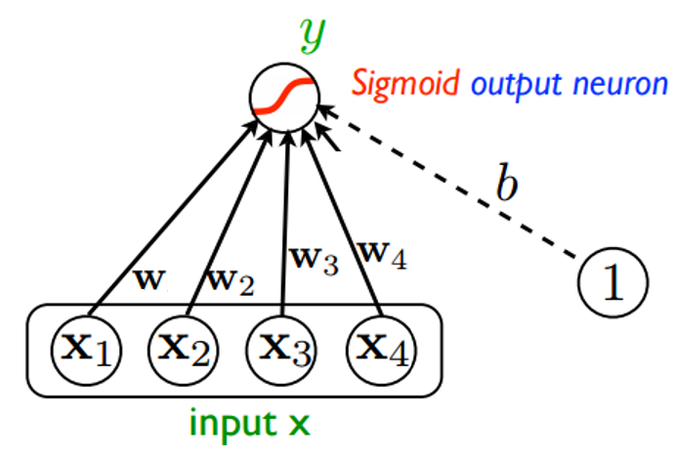
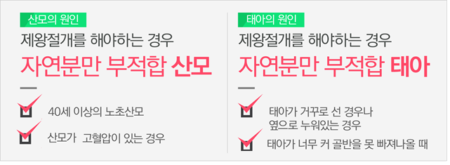
Logistic regression:
독립변수의 선형 결합을 이용하여 사건의 발생 가능성을 예측
학습을 통해 가중치를 정하자

Slide 7
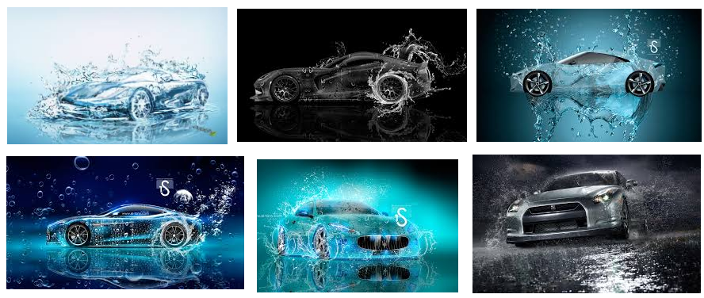
Feature 정하기의 어려움

Slide 8

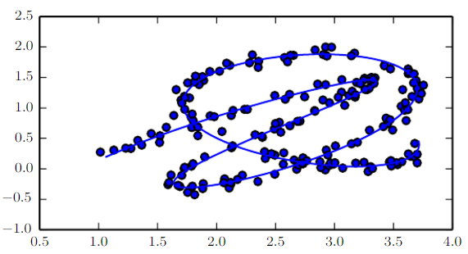
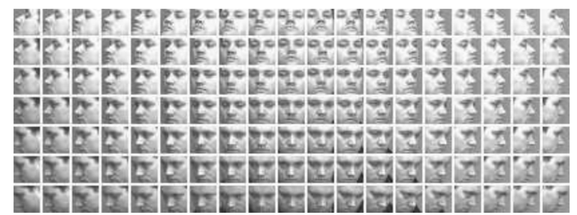
manifold hypothesis
출처: https://www.deeplearningbook.org/

Slide 9
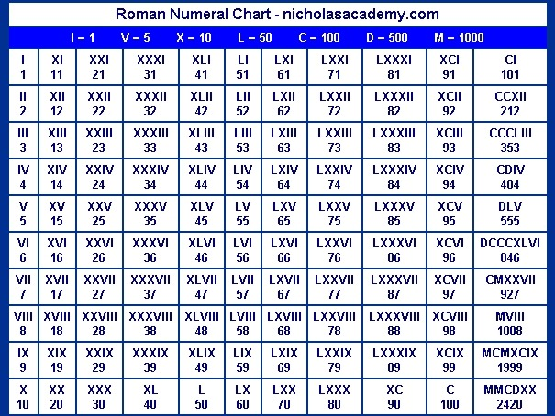
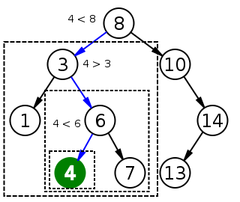
좋은 표현법

Slide 10
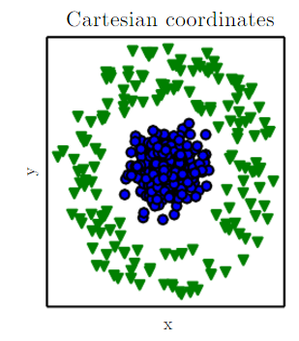
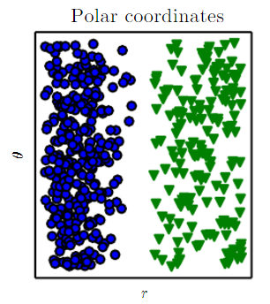
적합한 표현법
출처: https://www.deeplearningbook.org/

Slide 11
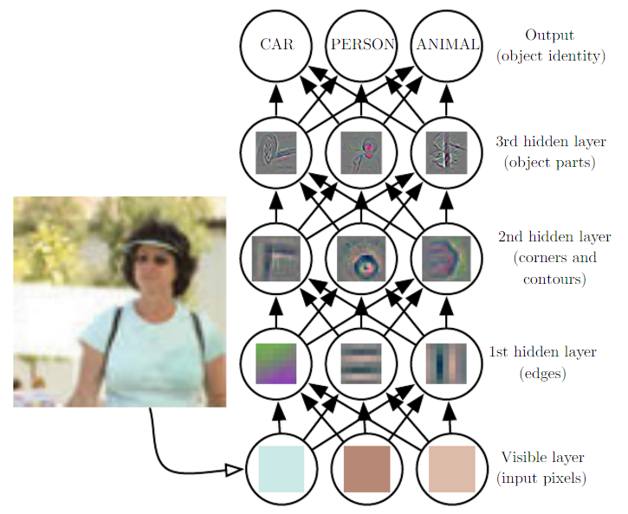
딥러닝 전략.
- 복잡함 = 단순함의 조합 - 고차원 정보 = 저차원 정보의 요약

Slide 12
MLP or Feedforward deep network – computation 관점
----------------------------------
z1 = g1(y1, y2), z2 = g2(y1, y2, y3) z3 = g3(y2, y3)
----------------------------------
y1 = h1(w1, w2)
y2 = h2(w1, w2, w3)
y3 = h3(w2, w3) ----------------------------------
w1 = h1(x1, x2)
w2 = h2(x1, x2, x3)
w3 = h3(x2, x3)
score_person(x1, x2, x3) = ?
(x1, x2, x3)

Slide 13
MLP or Feedforward deep network – computation 관점
f(x1, x2, x3) = f1(z1, z2, z3)
----------------------------------
z1 = g1(y1, y2), z2 = g2(y1, y2, y3) z3 = g3(y2, y3)
----------------------------------
y1 = h1(w1, w2)
y2 = h2(w1, w2, w3)
y3 = h3(w2, w3) ----------------------------------
w1 = k1(x1, x2)
w2 = k2(x1, x2, x3)
w3 = k3(x2, x3)
score_person(x1, x2, x3) = ?
(w1, w2, w3)
(x1, x2, x3)

Slide 14
MLP or Feedforward deep network – computation 관점
f(x1, x2, x3) = f1(z1, z2, z3)
----------------------------------
z1 = g1(y1, y2), z2 = g2(y1, y2, y3) z3 = g3(y2, y3)
----------------------------------
y1 = h1(w1, w2)
y2 = h2(w1, w2, w3)
y3 = h3(w2, w3) ----------------------------------
w1 = k1(x1, x2)
w2 = k2(x1, x2, x3)
w3 = k3(x2, x3)
score_person(x1, x2, x3) = ?
(y1, y2, y3)
(w1, w2, w3)
(x1, x2, x3)

Slide 15
MLP or Feedforward deep network – computation 관점
f(x1, x2, x3) = f1(z1, z2, z3)
----------------------------------
z1 = g1(y1, y2), z2 = g2(y1, y2, y3) z3 = g3(y2, y3)
----------------------------------
y1 = h1(w1, w2)
y2 = h2(w1, w2, w3)
y3 = h3(w2, w3) ----------------------------------
w1 = h1(x1, x2)
w2 = h2(x1, x2, x3)
w3 = h3(x2, x3)
score_person(x1, x2, x3) = f(z1, z2, z3)
(z1, z2, z3)
(y1, y2, y3)
(w1, w2, w3)
(x1, x2, x3)

Slide 16
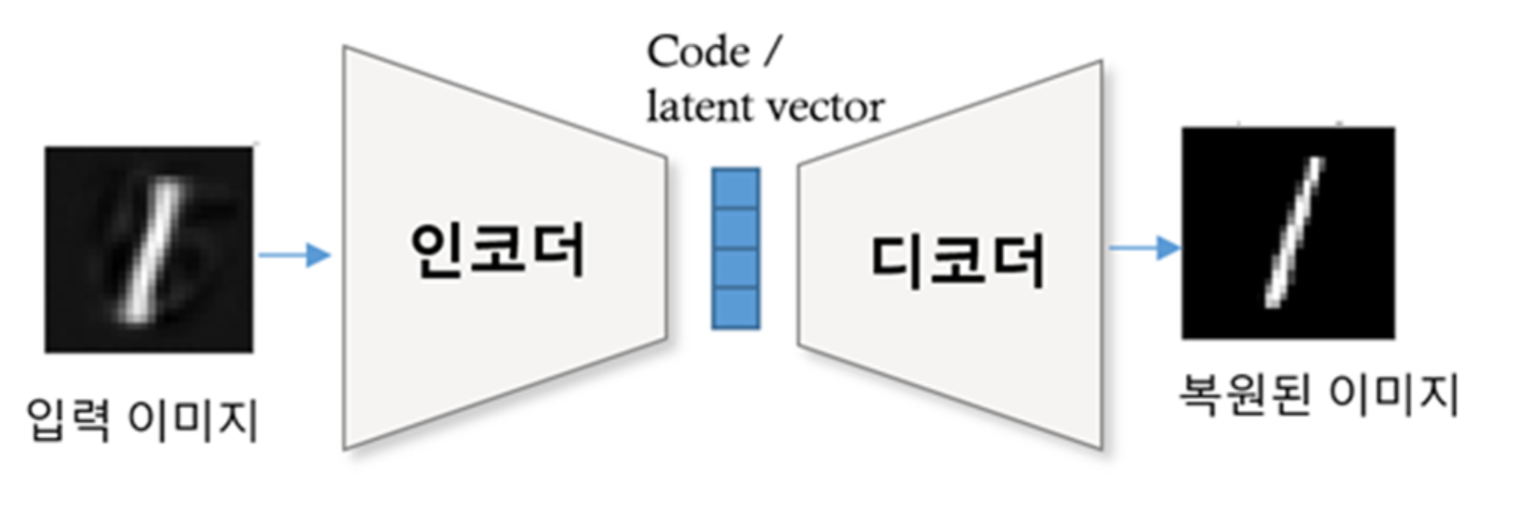
IT := Information Technology

Slide 17
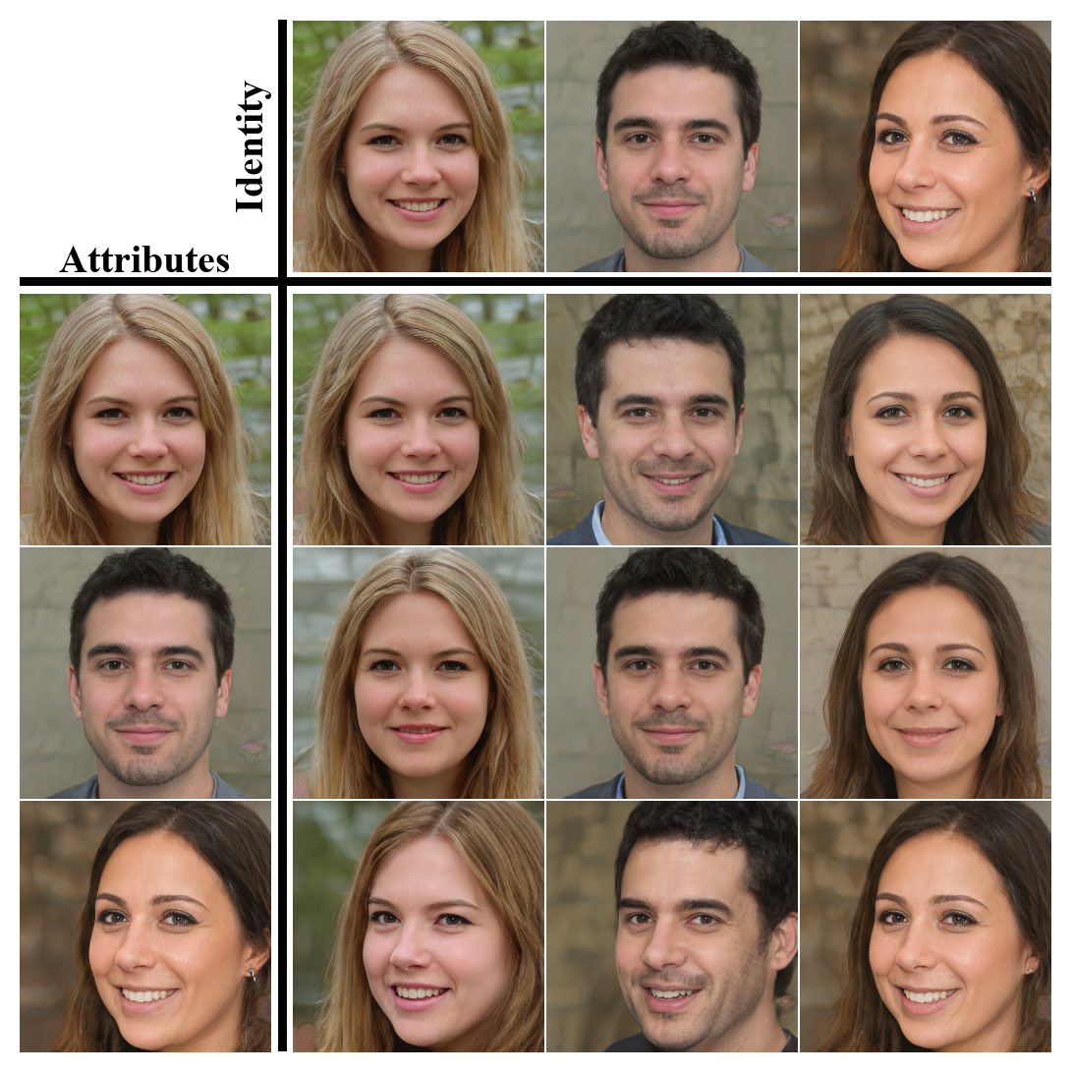
https://github.com/YotamNitzan/ID-disentanglement/blob/main/docs/imgs/teaser.png

Slide 18


disentanglement
Identity encoding
attribute encoding

Slide 19
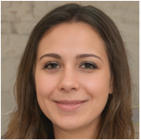

image editing in the latent space
Latent code 얻기
이미지 생성하기

Slide 20
Latent code 얻기
이미지 생성하기
+ ( - )

